Slide 1
November School-Based Family Data Night
Germantown Elementary
Thursday, November 18, 2021 – 6 pm
Notes:
Welcome to (insert school’s name) November School-Based Family Data Night!

Slide 2
VISION FOR STUDENT SUCCESS

Slide 5
Agenda
Purpose of School-Based Family Data Night
School’s Current Data and Academic Goals for 2021-2022
Assessment & Intervention Overview
SCS Commitment to Our Students
Student Data Discussion Transition
Next Steps & Closure

Slide 6
Purpose
Inform parents on student progress with various assessments
Provide guidance on how to read data reports
Provide recommendations on how to assist students
Notes:
Why are we here? The purpose of this family data night is to inform parents on student progress with various assessments, provide guidance on how to read data reports, and provide recommendations on how to assist students.

Slide 7
School’s Current Data and Academic Goals

Slide 8
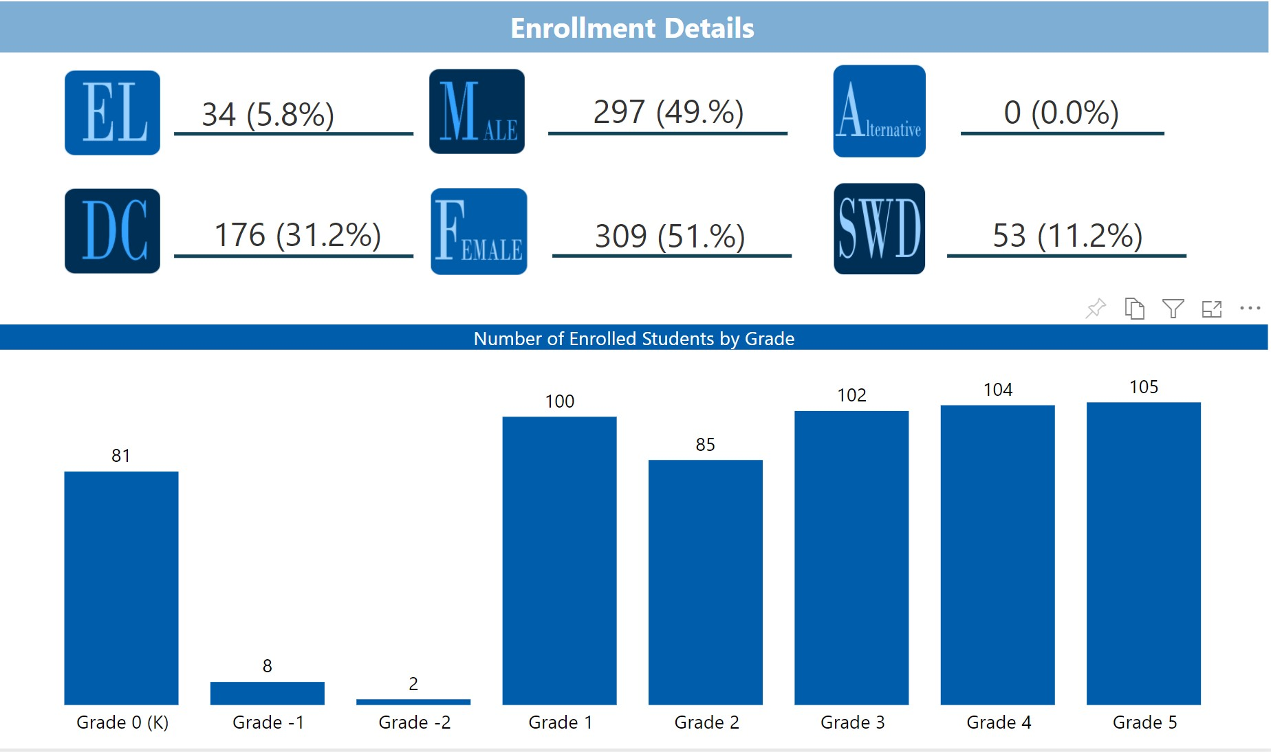
2
Enrollment and Equity
Notes:
Nearly all race categories

Slide 9
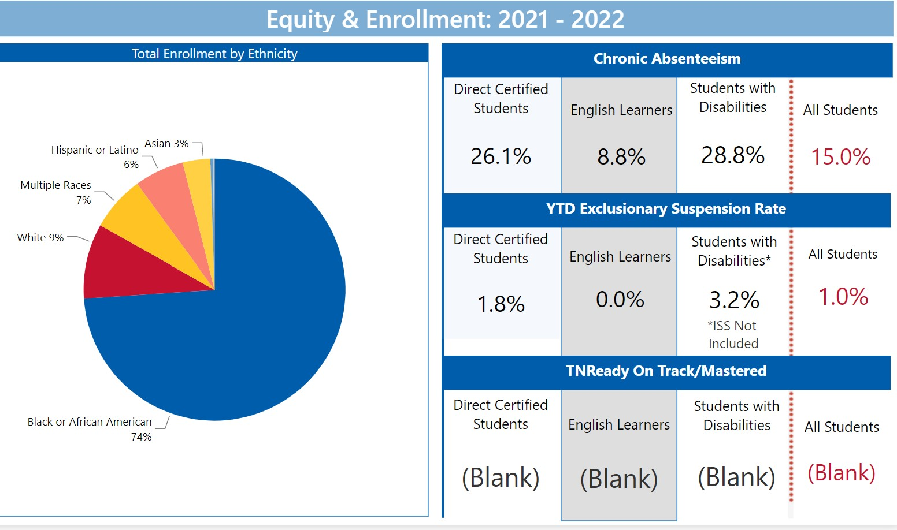
2
Enrollment and Equity
Notes:
Nearly all race categories

Slide 10
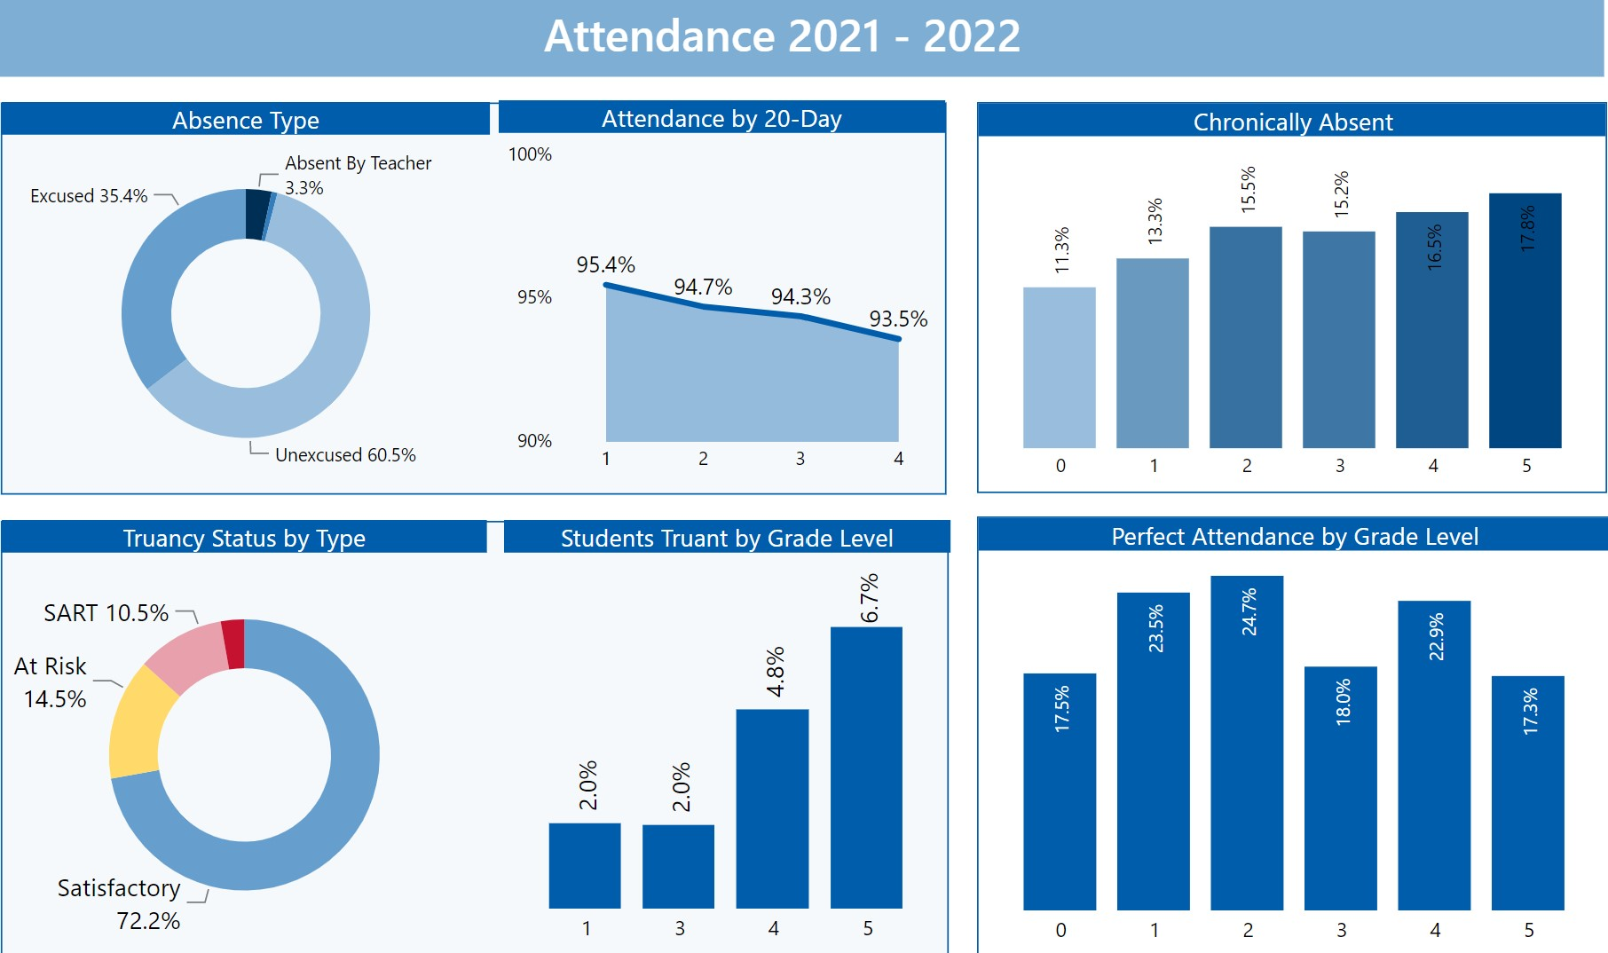
2
~ Absenteeism & Truancy ~
Attendance Goal for 2021-22: 94% Chronic Abs: <6%
Notes:
Nearly all race categories

Slide 11
GES AMOs – 21-22
Annual measurable objective (AMO) means the target used to determine student performance for NCLB. This law requires states to develop target annual measurable objectives that will determine whether a school, a district or the state as a whole is making adequate yearly progress toward the goals of having all students performing academically at an acceptable rate.
Notes:
Why are we here? The purpose of this family data night is to inform parents on student progress with various assessments, provide guidance on how to read data reports, and provide recommendations on how to assist students.

Slide 12
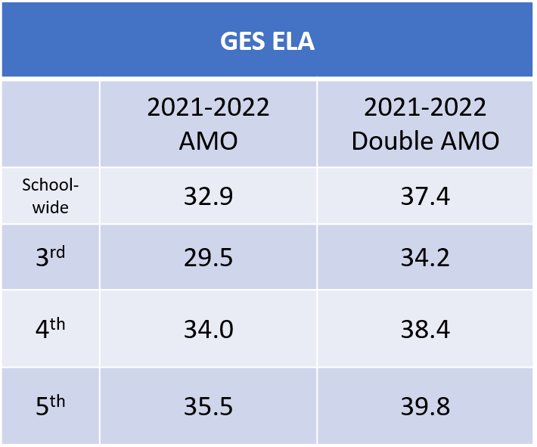
5
~ ELA Academic Progress/Goals ~
AMO for 2021-22- 32.9% Double AMO – 37.4%

Slide 13
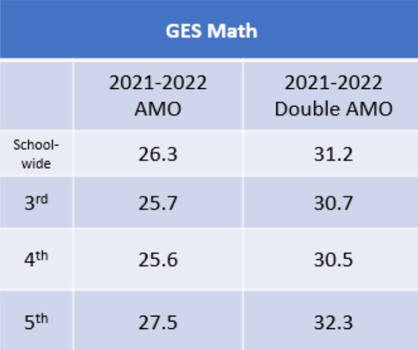
8
~ MATH Academic Progress/Goals ~
AMO for 2021-22: 26.3% Double AMO: 31.2%

Slide 14
11
~ SCIENCE Academic Progress ~
AMO for 2021-22: 34.4% Double AMO: 38.7 %
GES SCIENCE
 | 2021-2022 AMO | 2021-2022 Double AMO
School | 34.3 | 38.7
3rd | 35 | 39.4
4th | 40.2 | 44.2
5th | 28 | 32.9

Slide 15
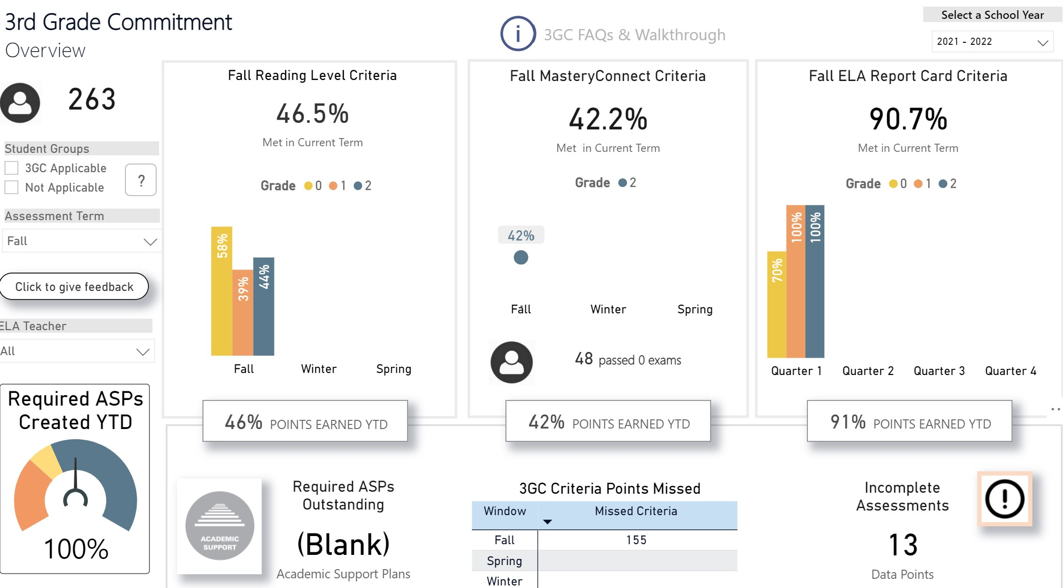
~ 3GC ~
14
3GC Goal for 2021-22: 75% of students meeting criteria for promotion to grade 3

Slide 16
Accessing and Viewing the Report Card

Slide 17
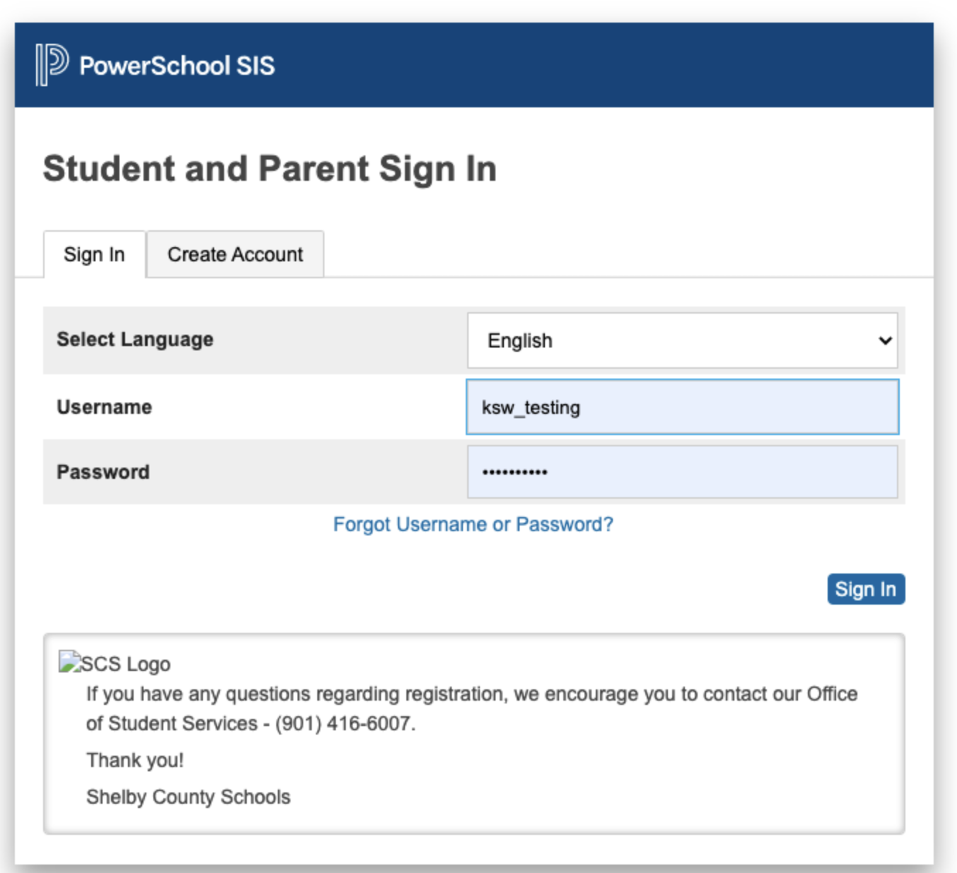
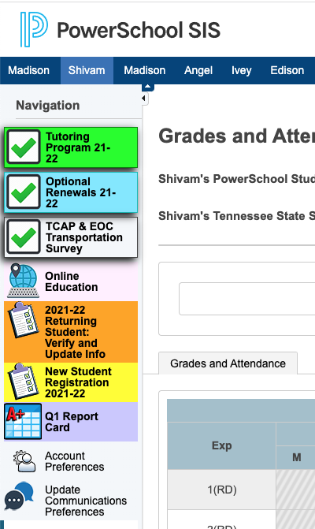
Accessing and Viewing the Report Card
Report cards will be available for the complete quarter once all school grades are stored and will be housed in the parent portal.
Access the report card, using the following link: https://scstn.powerschool.com/public/home.html
Sign into your parent account.
If you have forgotten the username or password, click on the “Forgot Username or Password” link.
After logging in, click the report card icon.

Slide 18
Accessing and Viewing the Report Card

Slide 19
District Assessments & Intervention
Notes:
Now we’re getting ready to provide an overview of the different assessments and interventions your child might be taking. Once we’ve reviewed this information, you will have the opportunity to meet with your child’s teacher to discuss your child’s individual data.

Slide 20
iReady
iReady is a computer-adaptive test (CAT) and covers all grade level standards.
Computer-adaptive tests continually adjust the difficulty of each test by determining each question based on the previous response.
The iReady assessment is used as a diagnostic screening tool to identify students who may need additional academic support and monitor student growth.
iReady is a K-8 intervention that provides specific tools and lessons to support areas with which the individual student is struggling.
In addition, iReady can help teachers determine appropriate instructional areas and skills to focus on during small group intervention instruction.

Slide 21
ILLUMINATE/FASTBRIDGE
Grades K-12 will participate in skill-based reading and math screener assessments.
Illuminate/FastBridge is the selected RTI² assessment platform for students in grades K-12.
Illuminate Education can be used in both special education and regular education in order to meet the state guidelines related to effective implementation of RTI².
Illuminate Education provides in-depth information on students' strengths and areas of need for specific skills in reading and math.
The goal of the process is to monitor student progress as the student receives intervention with the expectation that the intervention will result in the student achieving at high levels of learning while closing the achievement gap among same-age peers.

Slide 22
MASTERY CONNECT
Grades K-12 will participate in standards-based assessments aligned with district ELA, math, and science curriculum maps (which determine what standards are covered and when).
Mastery Connect is an assessment platform that allows teachers to assess student mastery of specific standards.
Students can receive results instantly.
The results are displayed by standard, so although students will still get an overall percentage on any assessment taken, the focus is on the mastery of the specific standards.

Slide 23
3rd GRADE COMMITMENT
Shelby County Schools identifies student achievement as its highest priority. The Shelby County School Board voted on a revision to Policy 5013 Promotion and Retention.
The revision was created to ensure we hold district and school leaders, teachers, and all stakeholders accountable towards ensuring SCS students have the necessary reading skills to be successful before they reach the third grade.
Third grade has been identified as the year that students are no longer “learning to read” but they begin “reading to learn.” If students are not reading on grade level by the time they reach the third grade, half of the curriculum they will be taught for the remainder of their school years will be incomprehensible.
Students who meet 8 of the 12 Criteria for Success at the conclusion of the second grade, will be eligible for promotion to the third grade.
The 3rd Grade Commitment is a collaborative effort between schools, parents and community towards ensuring we all work together to best help SCS students reach reading readiness before the third grade.

Slide 24
MasteryConnect Data

Slide 25
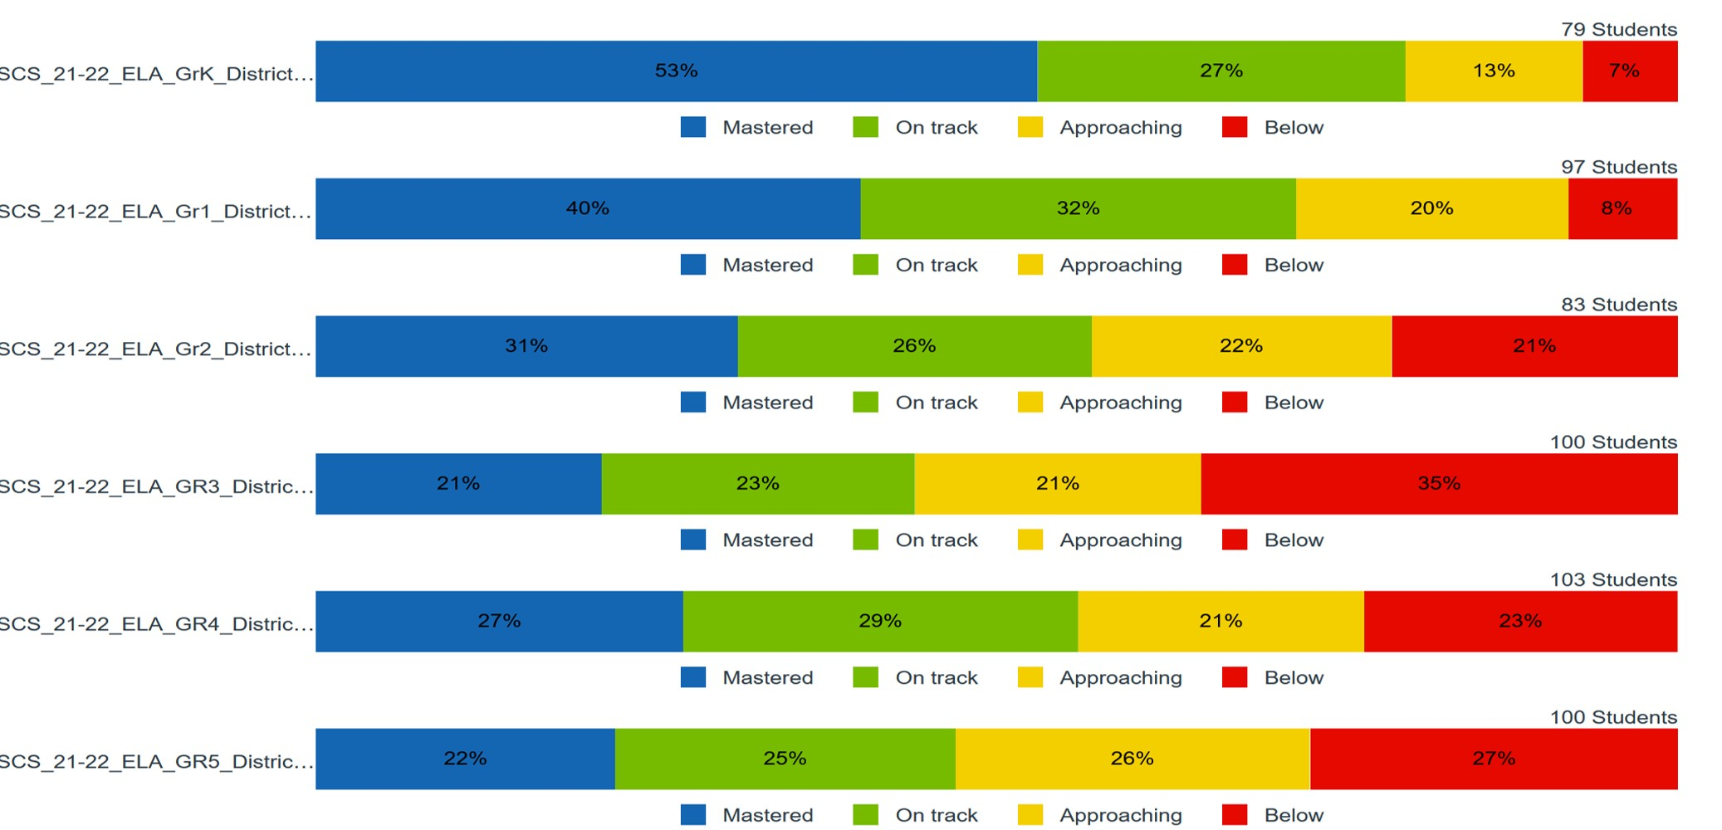
Mastery Connect – ELA District Formative Assessments
School should insert slide for ELA (grade level performance)

Slide 26
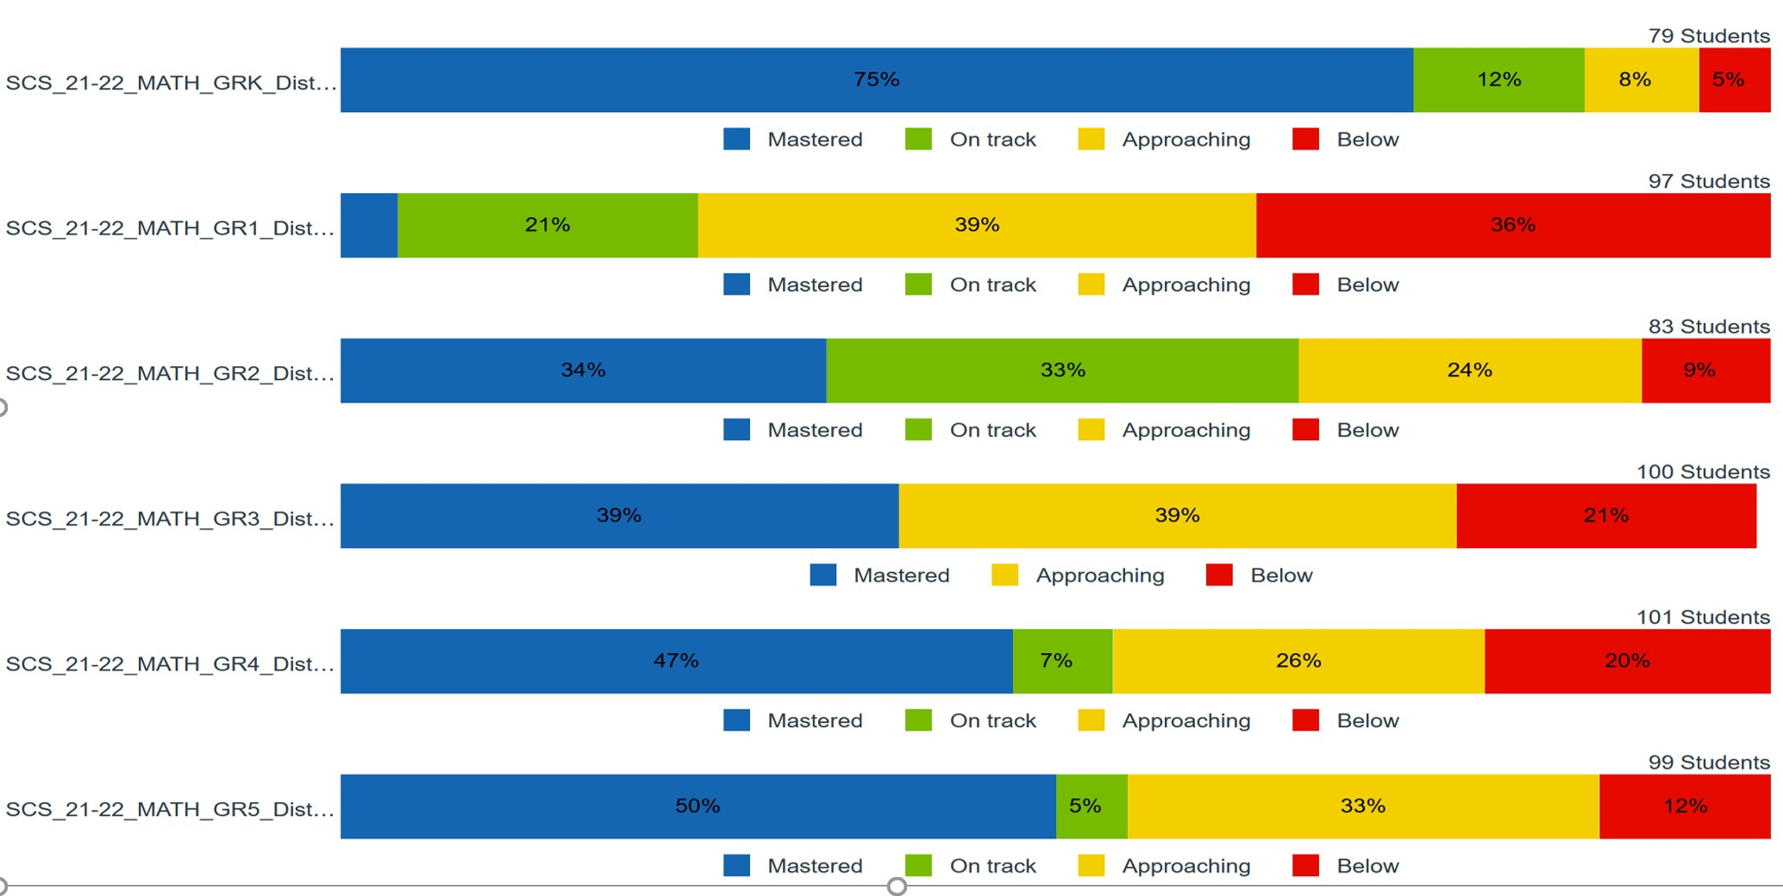
Mastery Connect – District Formative Assessments
School should insert slide for Math (grade level/course performance)

Slide 27
Mastery Connect – District Formative Assessments

Slide 28
iReady Data

Slide 29
iReady
School-wide Data

Slide 30
I-Ready Fall Diagnostic
ELA
Screenshot of iReady Diagnostic RLA Data

Slide 31
I-Ready Fall Diagnostic
MATH
Screenshot of iReady Diagnostic Math Data

Slide 32
Illuminate/Fastbridge Data

Slide 33
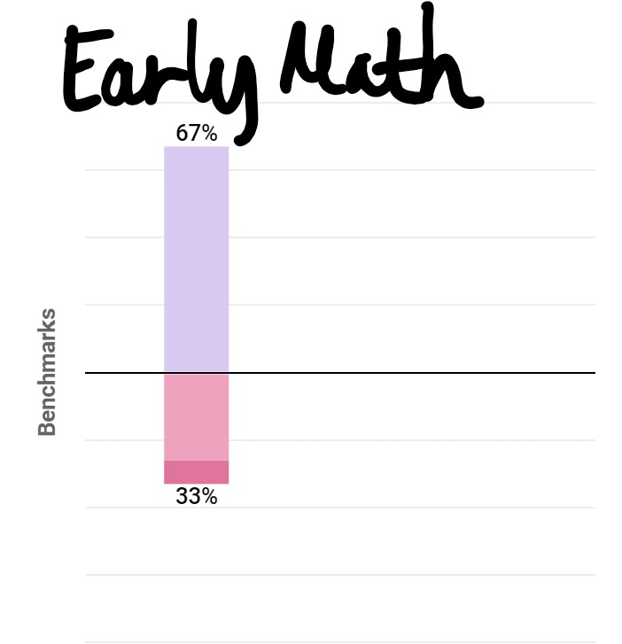
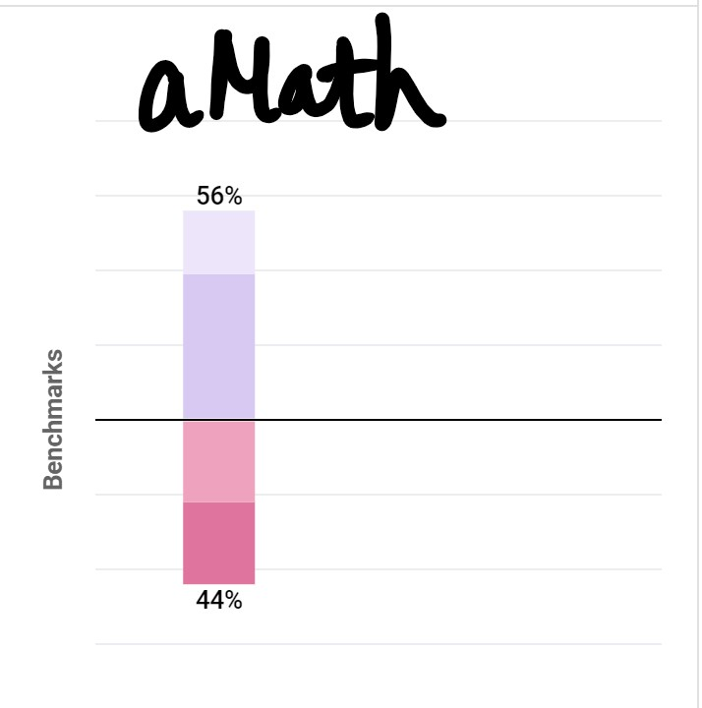
Illuminate/Fastbridge
K-2, EarlyMath 3-5, aMath

Slide 34
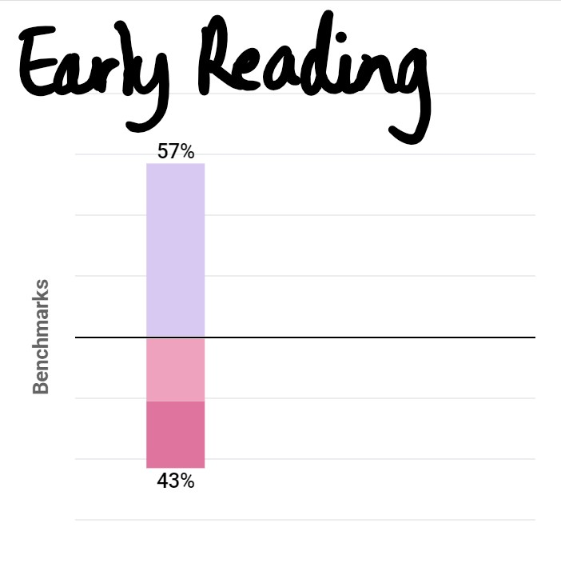
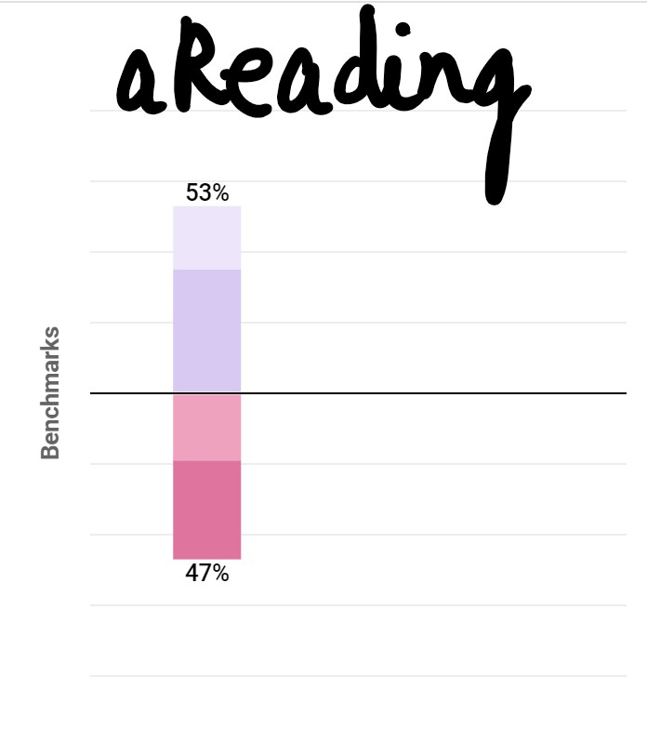
Illuminate/Fastbridge
K-2, EarlyReading 3-5, aReading

Slide 35
Shelby County Schools
Family and Community Engagement

Slide 36
Family and Community Engagement Ongoing Support
Monthly Family Forums: provide an opportunity for all parents to gather, learn and share important information to support student learning and success in school. Families can join the live virtual sessions on Microsoft Teams by visiting www.scsk12.org/familyforum

Slide 37
Family and Community Engagement Ongoing Support
Homework Hotline: Certified Teachers tutor K-12 Tennessee students in all core subjects
Help is offered in seven languages: English, Arabic, Spanish, Hindi, Farsi, Mandarin, and Swahili.
Teachers are available Mondays-Thursdays, 4p.m.-8p.m. via phone (901)416-1234 and webchat http://homeworkhotline.info/

Slide 39
Grade Level
Student Data Discussions
Notes:
Provide next steps for parents to review their child’s data
Share available resources for interpreting reports

